Slide 1








7 Weird Things you could see in a Deliverance Session
Exploring the surprising elements of spiritual encounters.
Lisa D. Piper & Amber Duncan
DrivenToBeFree.org

Slide 2







A Study Guide Resource
Soft Cover Study & Kindle

Slide 3

Coming Live 8/15. Available for purchase later.

Slide 4
Quick Startling Moves
Luke 9:39
And behold, a spirit seizes him, and he suddenly cries out; it convulses him so that he foams at the mouth; and it departs from him with great difficulty, bruising him.
May experience sudden, intense emotional outbursts.
Quick yells, or fast movements can startle and disrupt. Hand movements.
Others may exhibit physical movements or uncontrollable laughter, surprising everyone involved.
Suddenly gotta go. Unsettled.

Slide 5
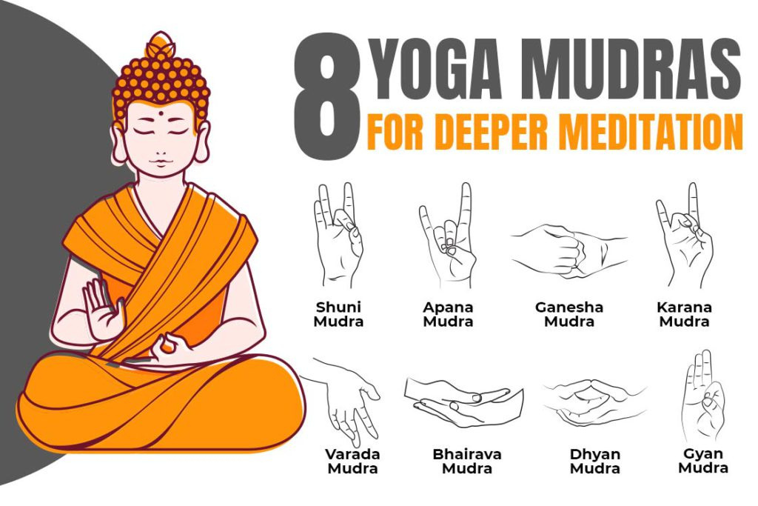

Sudden Hand Signals & Drawing Signs
During deliverance sessions, some individuals throw up hand signs which can be Hindu, witchcraft, etc.
Check for familiar spirit, occult involvement, etc.

Slide 6









Drawing Symbols
During deliverance, times of anointing, or when talking about trauma.

Slide 7


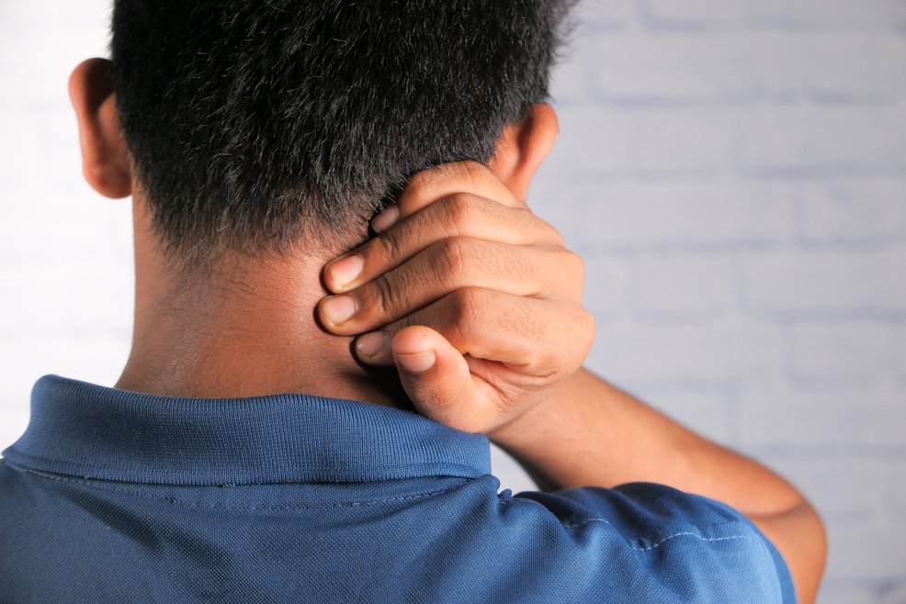
Unusual Physical Manifestations During Deliverance
During deliverance sessions, some individuals may exhibit unusual body contortions or spasms. These manifestations can be surprising to onlookers and may vary in intensity.
Two different kinds: 1 of the spirit acting out, or one when it’s leaving.
Things to consider: Hinduism influence, yoga, body memory, witchcraft

Slide 8

Sounds
Mark 1:23
Now there was a man in their synagogue with an unclean spirit. And he cried out,
There’s no reason to be afraid, but sounds may startle you!

Slide 9

Changes in Voice or Cursing
During a deliverance session, one of the most surprising phenomena is the alteration of speech patterns or even complete changes in voice.
Consider: demonic voice, shame or trauma response, spirits of antichrist, spirit of witchcraft, intimidation tactics, DID

Slide 10

Animal Sounds
Consider: Demonic, ritual abuse effect, DID and told theywere an animal, spirit guide, grief coming out sounding like a wounded animal, intimidation tactic

Slide 11

Chanting
Consider: Witchcraft, Hinduism, Programming from Ritual Abuse

Slide 12

Suddenly Asleep
Consider: Demonic effect or exhausted from the work, Leviathan and commanding awake.

Slide 13



Unexplained Cold Spots or Odors
During Deliverance
Sudden drops in temperature or odors can create a chilling atmosphere, making participants uneasy and heightening their sense of the supernatural.
Sudden Temperature Drops
Cold spots often appear unexpectedly, causing those present to feel a draft as if a window were opened.

Slide 14




Unexpected Focus Spiritual Objects
During deliverance sessions, various unexpected items may stand out...necklaces, rings, tattoos

Slide 15

Thank You for Joining Our August 2025 Driven Network Online class!
We appreciate your participation in our presentation about the 7 Weird Things You Could See in a deliverance session.

Slide 16

7 Things Weird Things Recap
  QUICK STARTLING MOVES
  THROWING UP SIGNS - DRAWING SYMBOLS
  UNUSUAL MANIFESTATIONS
  CHANGES IN VOICE, CHANTING
  SUDDENLY ASLEEP
  COLDNESS
  UNEXPECTED FOCUS ON SPIRITUAL OBJECTS

