Slide 1

11/13/25 NETWORK MEETING
Repression VS
Disassociation
Driven to be Free Magazine Network www.DriventobeFree.org

Slide 2
Repression Vs Disassociation
Resources:
The Truth about False Memories (Friesen)
The Body Keeps the Score (Van Der Kolk)
Switch On Your Brain (Leaf)

Slide 3
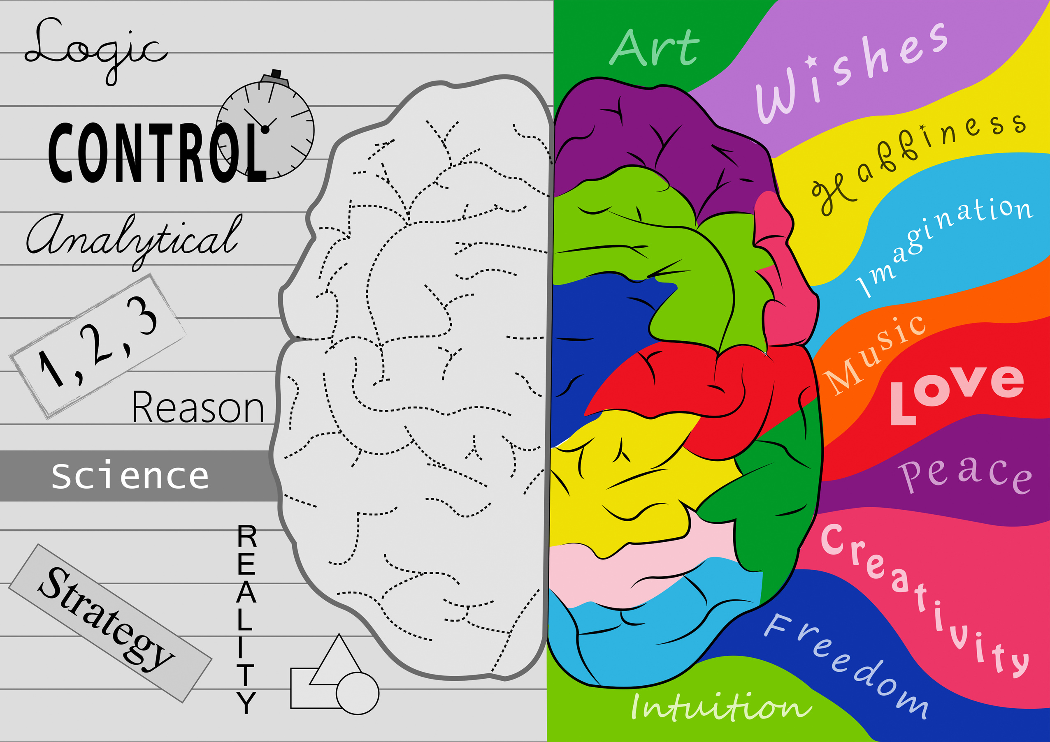


Slide 4


Repression
Disassociation
  Forgetting happens gradually
  Used to block painful memories
  Recorded in active mind
  Forgetting is instant without thinking
  Used to block painful memories
  Recorded in an isolated part of brain
Extracted from the book The Truth About False Memory Syndrome by Dr. James Friesen

Slide 5
Repression
Disassociation
  Voluntary
  Is an active process
  Memories return gradually
  Involuntary
  Disconnects like it never happened
  Memory returns suddenly. When flashback.
Extracted from the book The Truth About False Memory Syndrome by Dr. James Friesen

Slide 6
Repression
Disassociation
  Helps make things appear better than they were, not worse.
  Processed repeatedly to make what happened more acceptable.
  Makes things appear like they never happened
  Not processed.
Extracted from the book The Truth About False Memory Syndrome by Dr. James Friesen

Slide 7
Repression
Disassociation
  Memory is subjected to interpretation & re-interprestation over a period of time throughout a person’s life. Can be modified to make it acceptable. Original event becomes incresilyl diffilt to recall accurately. Can be modified until forgotten.
  Not modified, not reinterpreted. Returns with little distortion when returning. Can be like reliving the orginal event.
Extracted from the book The Truth About False Memory Syndrome by Dr. James Friesen

Slide 8
Repression
Disassociation
  Mind uses rpression to see the world through “rose colored glasses.”
Extracted from the book The Truth About False Memory Syndrome by Dr. James Friesen

Slide 9
Repression
Disassociation
  3rd Person’s memory feels like it happened to someone else.
  Memory has no point of conflict with other information in the mind.
  1st Person’s memory feels like, “it happened to me.”
  As memory returns, distortion clears about specific events.
Extracted from the book The Truth About False Memory Syndrome by Dr. James Friesen

Slide 10
Repression
Disassociation
  Once repression is removed, memory and emotion do not go away; they now have to deal with memory w/o a coping mechanism.
  Memories of abuse seep into daily life.
  Experience recorded in memory precisely.
Extracted from the book The Truth About False Memory Syndrome by Dr. James Friesen

Slide 11
Repression
Disassociation
  Distortions can be recorded from a purposeful mislead (like someone dressing up as another person) – Distortions include time and place, fatigue, clarity, or sequence of the event. Difficulties if a person was drugged could distort
  If there are misconceptions, they are recorded too. (e.g.: someone is dressed up like Jesus & influence abuse...that distortion is recorded.)
Extracted from the book The Truth About False Memory Syndrome by Dr. James Friesen

Slide 12
Disassociation
·Sudden mood shifts
·Denial of actions observed by others
·Forgetfulness (despite high intelligence)
·Evidence of internal dialogue
·Flashback – 4 or more suggest DID
Extracted from the book The Truth About False Memory Syndrome by Dr. James Friesen

Slide 13

How Might Recorded Memory be DISTORTED?
  Perpetrators of abuse using
  Costumes
  Sets/Stages
  Drugs
  Hypnosis/Hypnotic suggestions
  Alter Personalities programmed
  Artificial information on video or images used to implant memory under hypnosis

Slide 14
Real Memory Signs
  The memory is NEW information. Like a surprise.
  Body Memory
  Relief or healing upon recovery of the memory
  The pieces fit with ongoing issues or triggers
  Confirmation from the Lord Jesus Christ or Holy Spirit
  Physical validation of a place or object (memories match unknown marker, journal, diary, etc.)
  Repetitive in dreams (hiding, running, escaping)

Slide 15

John 8:32
And you shall know the truth, and the truth shall make you free.” NKJV

Slide 16
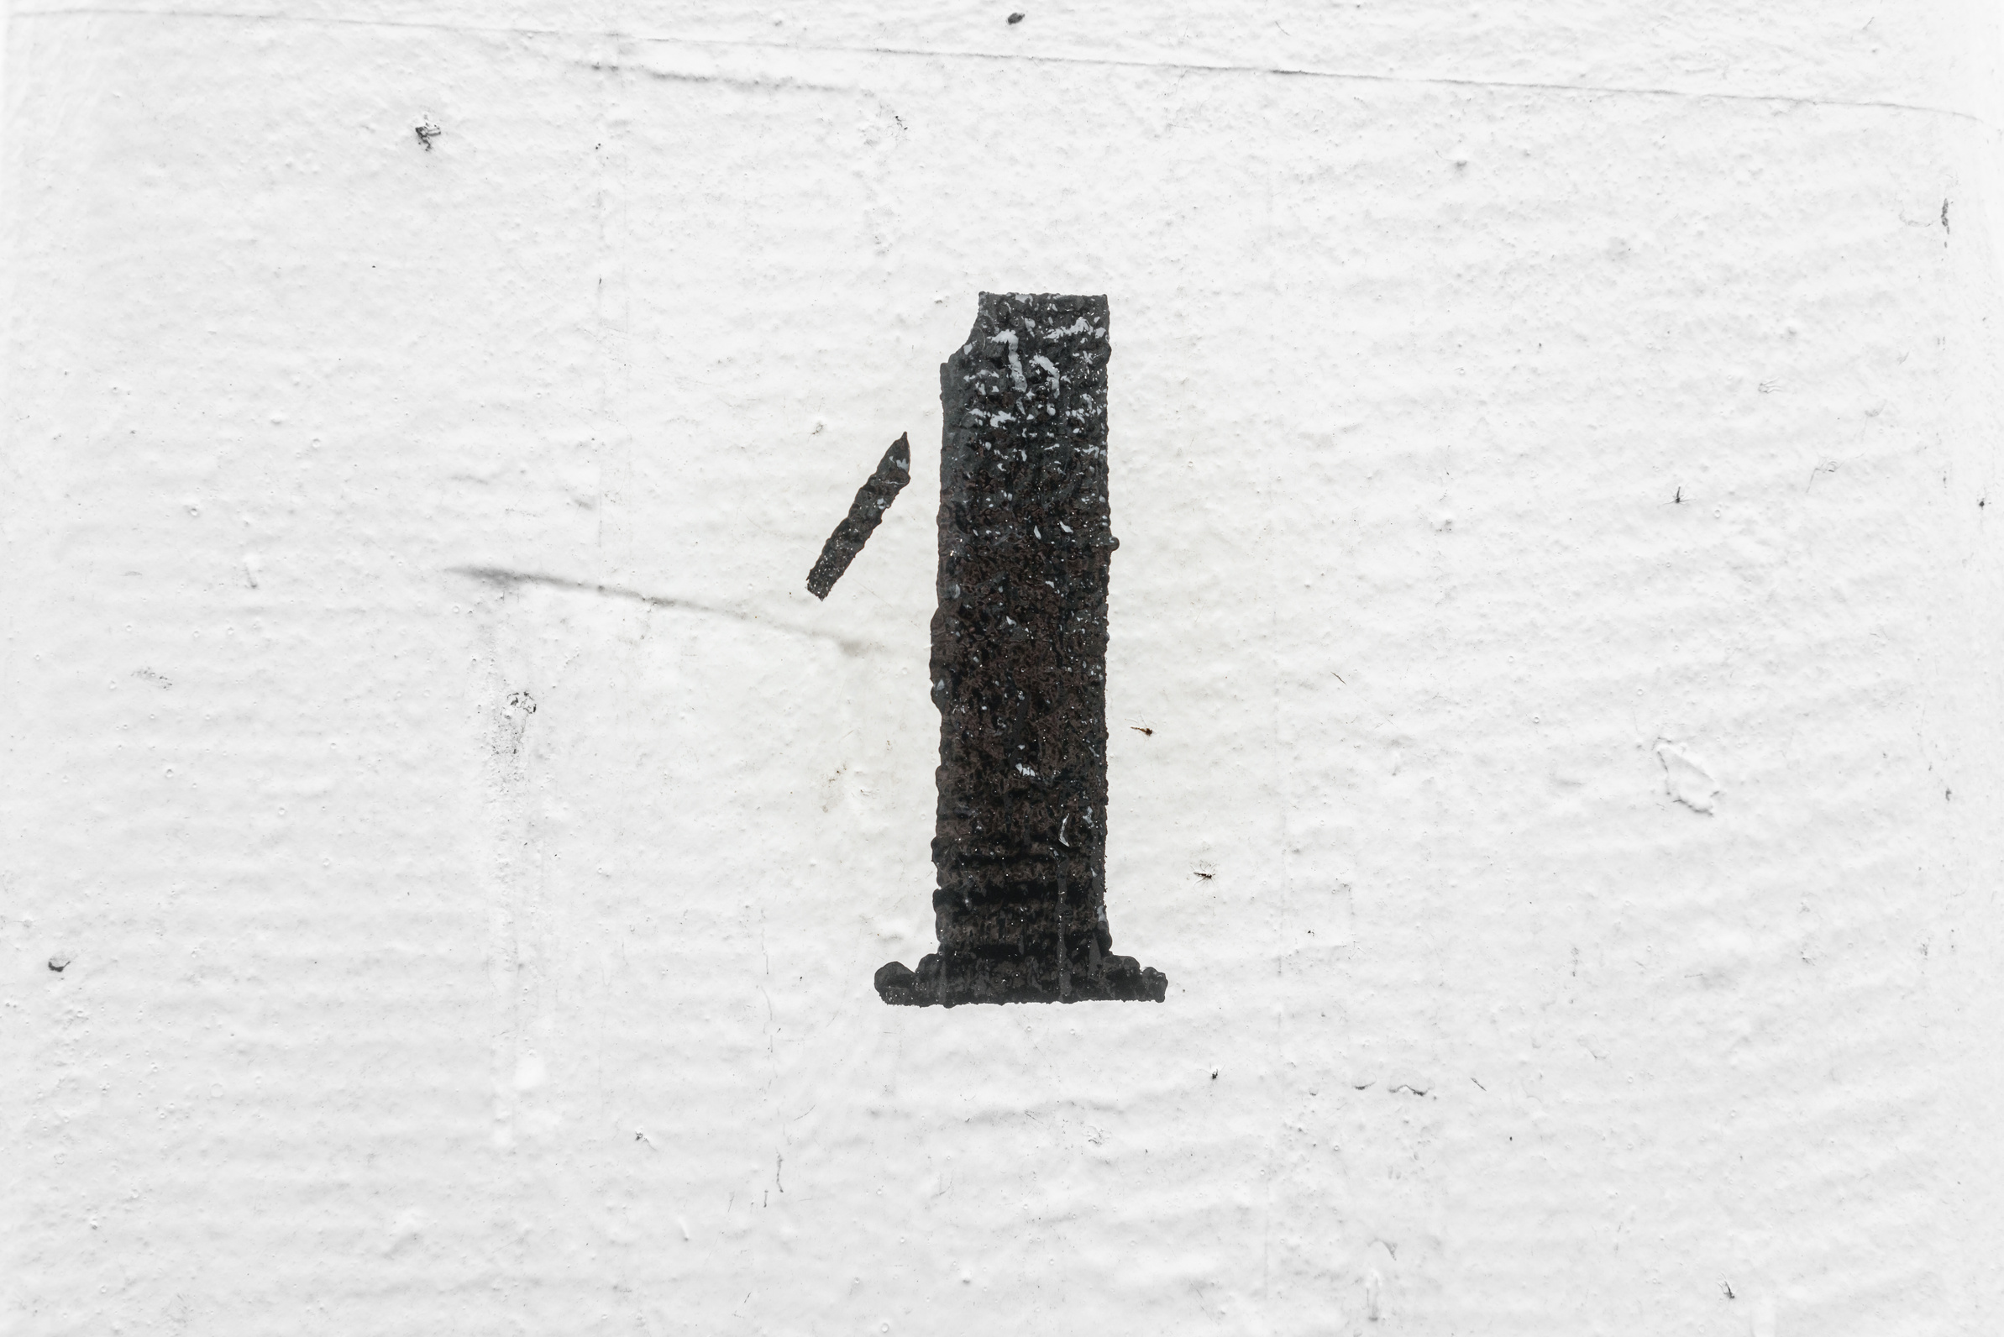
Know the Truth
If the library is locked, it needs to be released to the Lord, or if necessary, out of the right brain and into the left for healing.

Slide 17

Ways to get the trauma out:
  Ask the Lord, He will illuminate it!
  The right side of the brain is picture-activated, not words!
  Ask the Lord to help you through drawing, clay, collage, sand trays, etc.

Slide 18

Invite the Truth. His name is Jesus.
When a mormory, emotion, or thought comes up, examine it through lense of scripture, and prayer. You can even ask Him the truth you need or where He was in the moment. It’s a fast track to healing!

Slide 19
Psalm 34:15
The eyes of the Lord are on the righteous, And His ears are open to their cry. NKJV
Psalm 139:2
You know my sitting down and my rising up; You understand my thought afar off. NKJV

